Slide 1


A Terragni
Case Study
Driving Growth in Life Insurance
TERRAGNI CONSULTING (P) LTD PRIVATE AND CONFIDENTIAL ©

Slide 2

Client Background
Challenge
What We Did
Opportunities
Solutions
Samples
Business Outcomes
Our Methodology
Top 4
638
Players In Private Life Insurance Sector
Offices pan India
A Large Workforce Of Insurance Advisors And Other Channel Intermediaries
TERRAGNI CONSULTING (P) LTD PRIVATE AND CONFIDENTIAL ©

Slide 3

Client Background
Challenge
What We Did
Opportunities
Solutions
Samples
Business Outcomes
Our Methodology
Customer retention and growth
Low Persistency rate of life insurance policies after 1/3/5 years of sales
Over 75% of premium collected through non digital methods (cash, cheque, DD)
More than 63% of customers are not aware or not comfortable with digital payment gateways for renewals
TERRAGNI CONSULTING (P) LTD PRIVATE AND CONFIDENTIAL ©
Notes:
Lack of information as a product category & financial instrument
(Life Insurance)

Slide 4



Client Background
Challenge
What We Did
Opportunities
Solutions
Samples
Business Outcomes
Our Methodology
Barriers to engagement with Insurance
Emotions and attitudes associated with the product category & their impact on customer behaviour
Barriers to engagement with the Brand
  Emotions and attitudes associated with the brand, product & touchpoints & their impact on customer behaviour
Barriers to premium renewal transaction
Areas of high effort and friction in the renewal transaction
TERRAGNI CONSULTING (P) LTD PRIVATE AND CONFIDENTIAL ©

Slide 5

Client Background
Challenge
What We Did
Opportunities
Solutions
Samples
Business Outcomes
Our Methodology
Emotional Anchors
Contextual Relevance - Goal relevance and Regulatory Focus
Concepts to Specifics Gap – while life insurance deemed relevant as a category, no salience attached with own specific policy
Transparency – Totality & Intuitiveness
Consistency-Across the entire lifecycle
Flexibility- Ability to control outcome
TERRAGNI CONSULTING (P) LTD PRIVATE AND CONFIDENTIAL ©

Slide 6
^{Quantitative Insights}
Client Background
Challenge
Opportunities
Our Methodology
What We Did
Solutions
Samples
Business Outcomes
¹
^{5 lakh+ Records –}
^{3 Years Time Span}
^{Qualitative Insights}
²
Phenomenological in-depth interactions for episodic recall.
One-on-One in-depth interactions,
53 hours of interview transcripts
Consumer Neuroscience Based Widespan Assessment
³
Released to all the customer online studies testing: Trustworthiness, Touch Points Interaction Friction, Redemption Insights
TERRAGNI CONSULTING (P) LTD PRIVATE AND CONFIDENTIAL ©

Slide 7

Client Background
Challenge
What We Did
Opportunities
Our Methodology
Solutions
Samples
Business Outcomes
Our Methodology
Design
Relevant and timely nudges to drive customer behaviour shifts (EAST* framework for behaviour shifts)
Re-Design
Premium Renewal Processes
Touchpoints
Customer Communication
Customer Data Enrichment
For focused solution delivery
TERRAGNI CONSULTING (P) LTD PRIVATE AND CONFIDENTIAL ©

Slide 8


Client Background
Challenge
What We Did
Opportunities
Our Methodology
Solutions
Samples
Business Outcomes
Our Methodology
Overcoming barriers to Premium Renewal
Communication architecture revamp
Renewal communication architecture need to be revamped
Relooking and revamping payment experience through all medium for customer ease, efficiency and enablement
TERRAGNI CONSULTING (P) LTD PRIVATE AND CONFIDENTIAL ©

Slide 9
Client Background
Challenge
What We Did
Opportunities
Our Methodology
Solutions
Samples
Business Outcomes
Our Methodology
Ways ahead
Communication model
Triggering
Customer context based
Attention
Customer segment based
Curiosity
Behaviour
TERRAGNI CONSULTING (P) LTD PRIVATE AND CONFIDENTIAL ©

Slide 10
Client Background
Challenge
What We Did
Opportunities
Our Methodology
Solutions
Samples
Business Outcomes
Our Methodology
Communication to overcome barriers to renewal
Intended outcomes
Communication categories
Bridging the concepts to specifics gap
Renewal Communication
Increasing Policy Stickiness
Product Benefits
Enhancing customer connect
Customer Engagement
Enhancing digital (online) ease
Data Enrichment
Seasonal Communication
TERRAGNI CONSULTING (P) LTD PRIVATE AND CONFIDENTIAL ©

Slide 11


SAMPLE
For illustrative purposes only
Remember!
Your premium is due!
Every step towards your child’s dreams counts.
And you’re about
to miss one!
Goal relevance
Take
the step.
Pay your policy premium now.
Evolve
Insurance
TERRAGNI CONSULTING (P) LTD PRIVATE AND CONFIDENTIAL ©

Slide 12
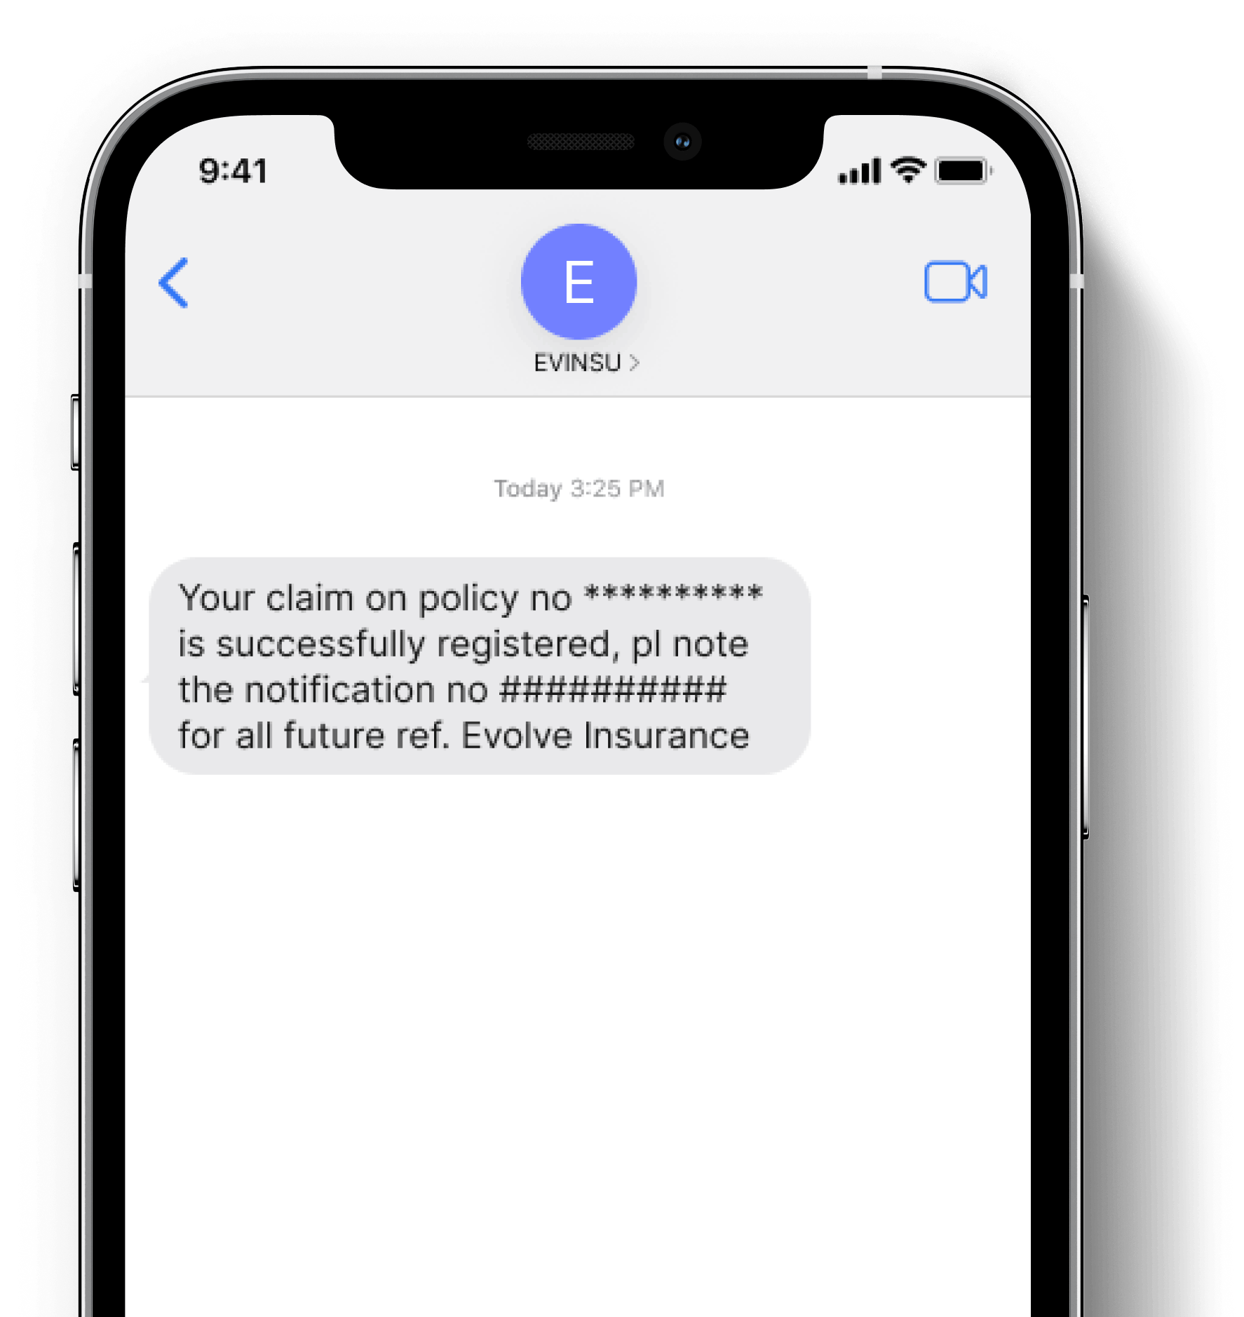
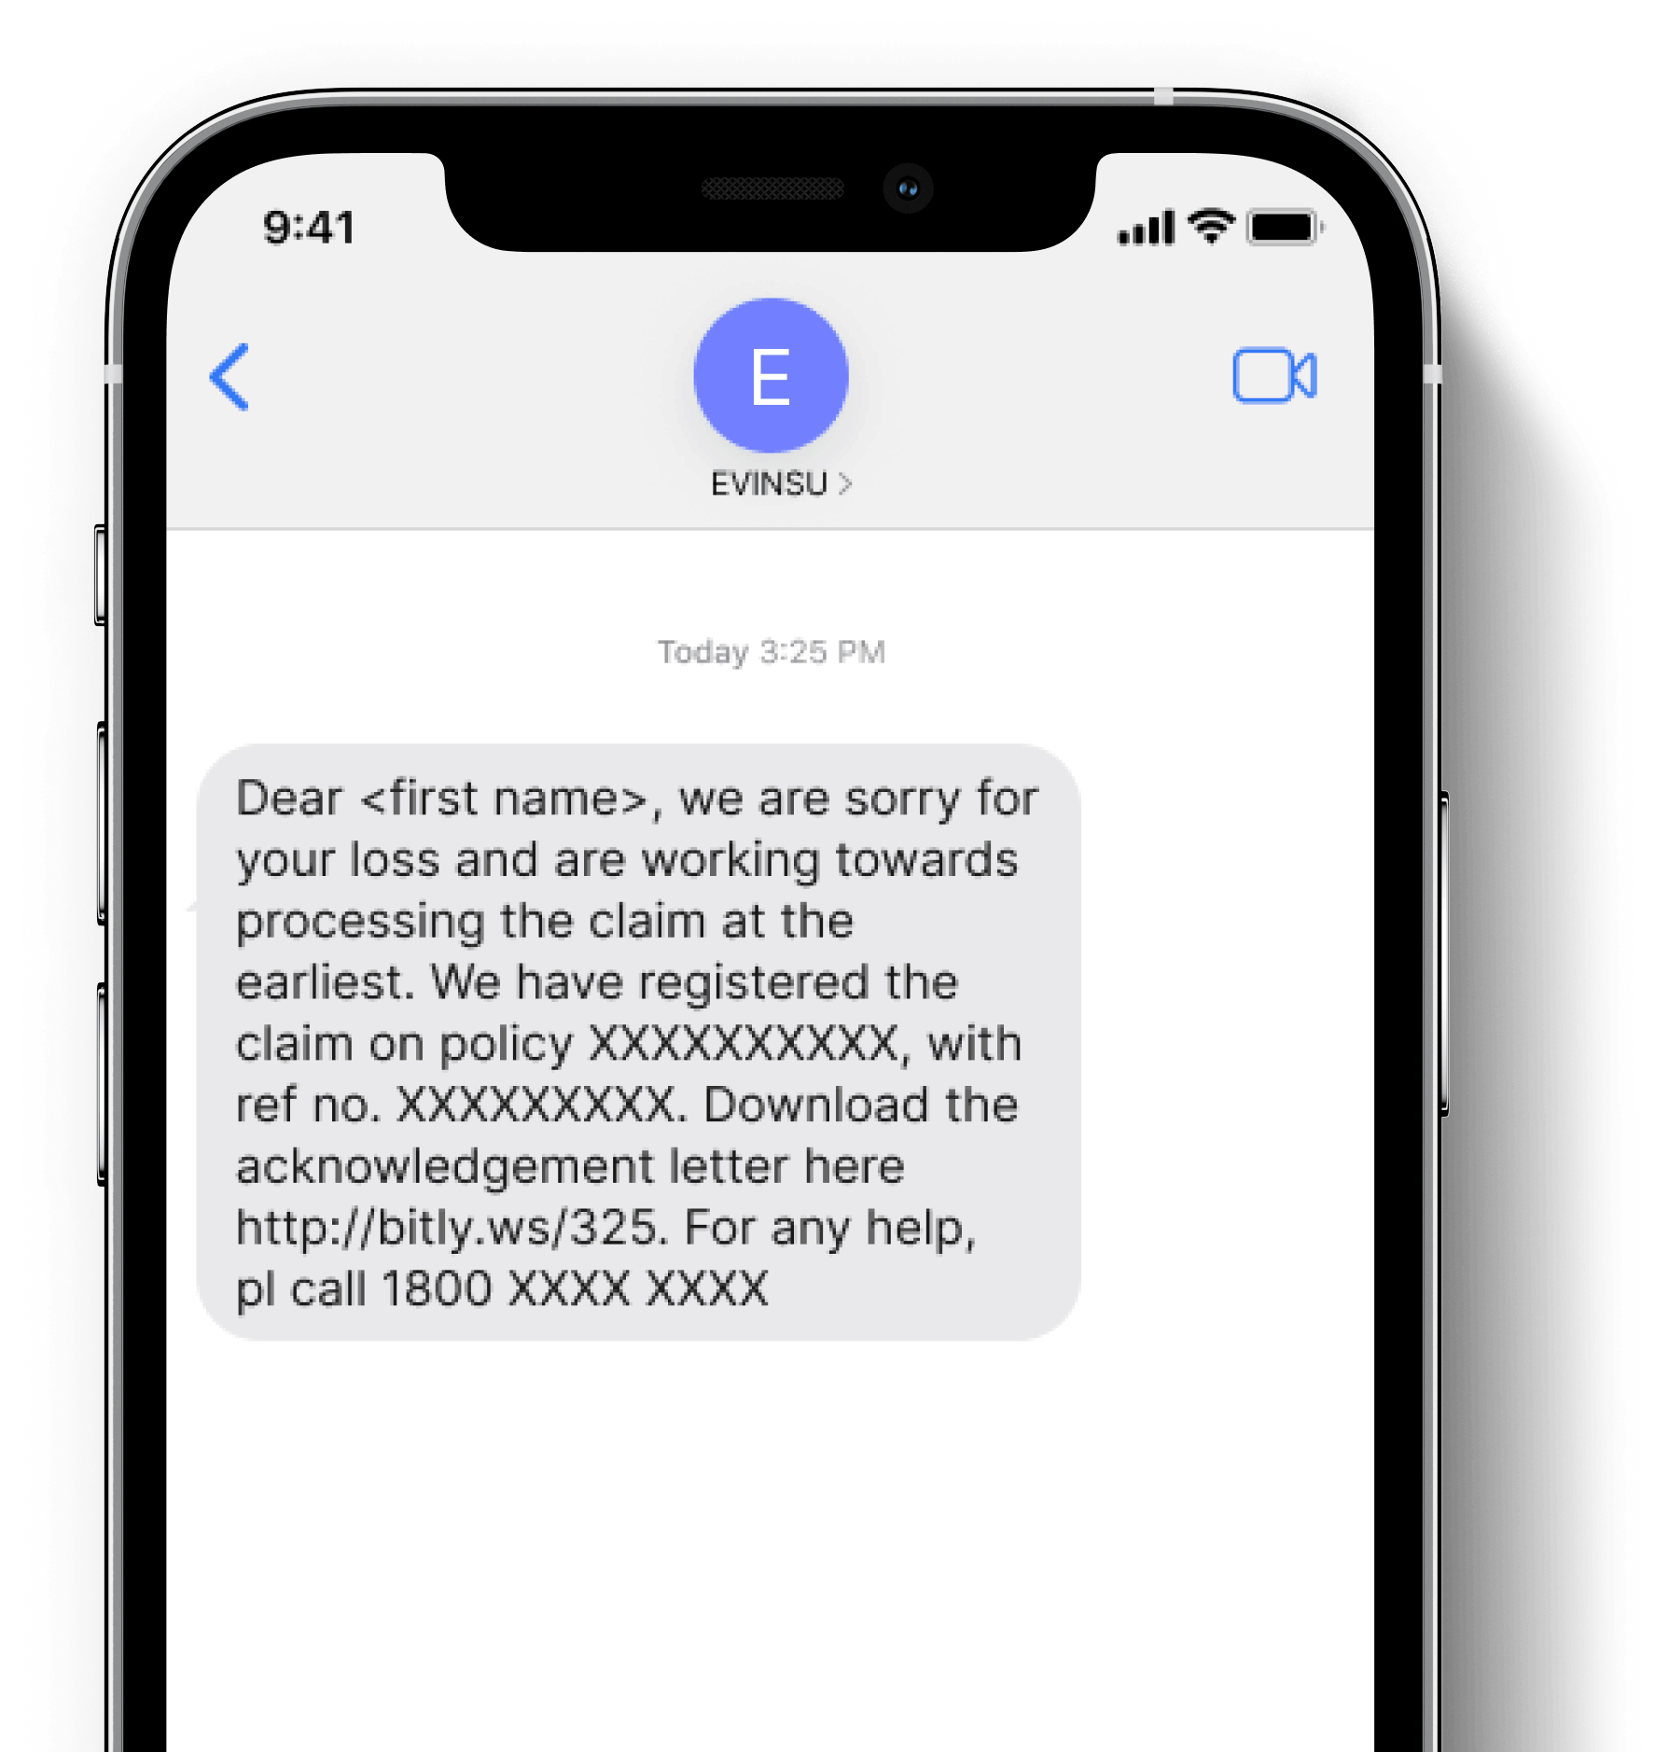

SAMPLE
For illustrative purposes only
Before
After
Empathy Gap
TERRAGNI CONSULTING (P) LTD PRIVATE AND CONFIDENTIAL ©

Slide 13
SAMPLE for Star Health
For illustrative purposes only
Reassurance
Perception of ease
Empathy
Before
After
Dear Customer, besides Network Hospitals, you can now avail cashless facility at any hospital of your choice. Please make sure that you intimate the claim 48 hours before hospitalisation for planned treatment and within 24 hours in case of hospitalisation. Call 044-6900 6900 to know more – STAR Health
Dear [Name], you can now avail cashless facility at any hospital of your choice. All of you have to do is notify us 48 hours in advance for planned treatments or within 24 hours of hospitalisation, and we'll take care of the rest.
For more information, reach out to us at 044-6900 6900. We're committed to providing the best care possible, wherever you are.
Warm regards,
STAR Health
TERRAGNI CONSULTING (P) LTD PRIVATE AND CONFIDENTIAL ©

Slide 14

Client Background
Challenge
What We Did
Opportunities
Our Methodology
Solutions
Samples
Business Outcomes
⬆Improved Persistency
⬆Enhanced Digital (online) Adoption
⬇Reduced Cost of Service
⬆Enhanced Customer Connect and Contactability
TERRAGNI CONSULTING (P) LTD PRIVATE AND CONFIDENTIAL ©

Slide 15
dipti@terragni.in
+91 895 698 2522
Thank You
TERRAGNI CONSULTING (P) LTD PRIVATE AND CONFIDENTIAL ©

Slide 16



India
London
Bucharest
www.terragni.in
www.buyerbrain.com
TERRAGNI CONSULTING (P) LTD PRIVATE AND CONFIDENTIAL ©

